Slide 1
Economic analysis for Construction of a new Warehouse
Rishi Siddhanth Yaga
Yerramorrusu Harshitha
Sri Mahitha Karuturi
Architha Surabhi

Slide 2
Introduction
The automobile industry is constantly evolving with new technologies and emerging to improve their services and outcomes.
To accommodate the parts and equipment, we need a new Warehouse.
However, Introducing a new Warehouse significant financial investment.
The purpose of this project is to conduct an economic analysis for a new warehouse to determine its financial feasibility.

Slide 3
Project Description
A Thirty-thousand square-foot Warehouse Facility is to be constructed by an Automobile Company in New York State.
Four project alternatives have been considered. For these four scenarios, NPV and IRR are used to calculate and determine which of the four is more economical.
All the scenarios have several expenses including site work, design fee, construction and resources, civil engineering, building maintenance and operating costs, labor costs etc.

Slide 4
Analysis Method
For this project, NPV and IRR are used to calculate and determine the economic feasibility
NPV considers the time value of money by discounting the future cash flows to their present value based on a specified rate. This allows for a fair comparison of the investment's cost and expected return, considering the timing of the cash flows.
IRR provides a clear and concise measure of the expected profitability of the investment.

Slide 5
Project Alternatives
Construction of warehouse in 6months
Construction of warehouse in 1 year
Renting the entire warehouse after construction
Renting half of the warehouse and utilizing the remaining half for transport and storage

Slide 6
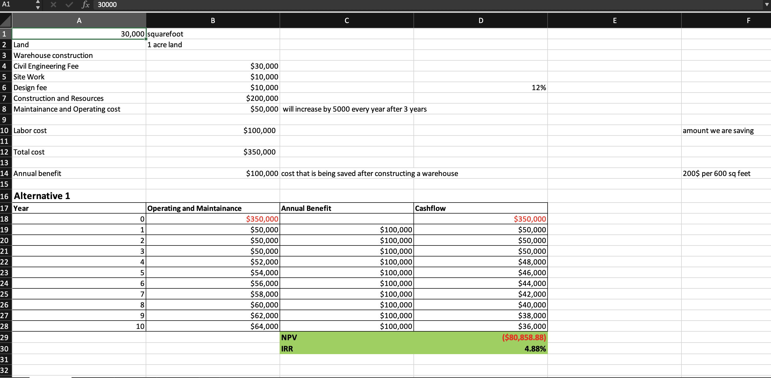
Alternative 1

Slide 7
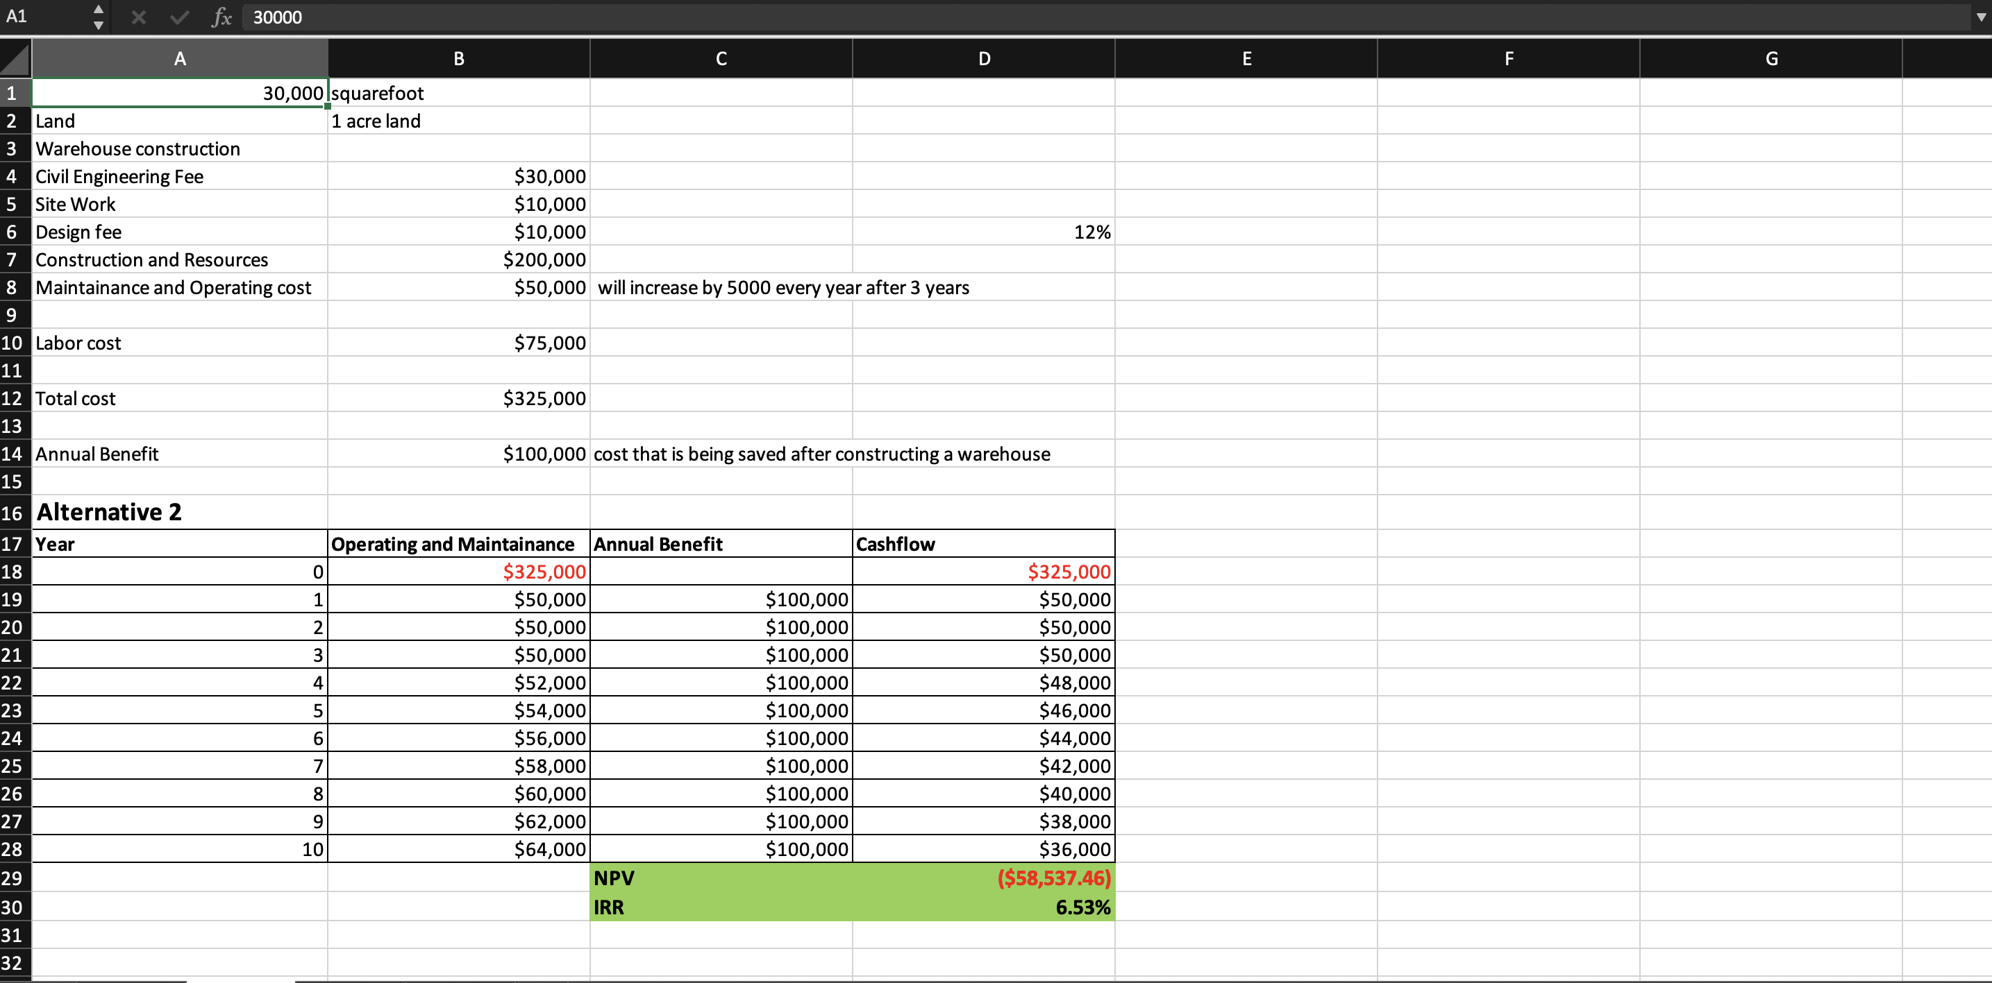
Alternative 2

Slide 8
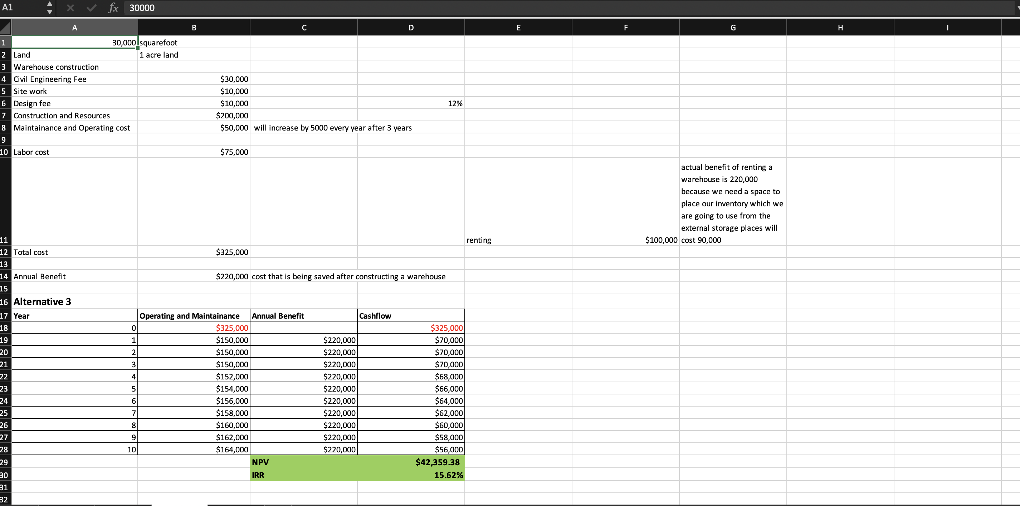
Alternative 3

Slide 9
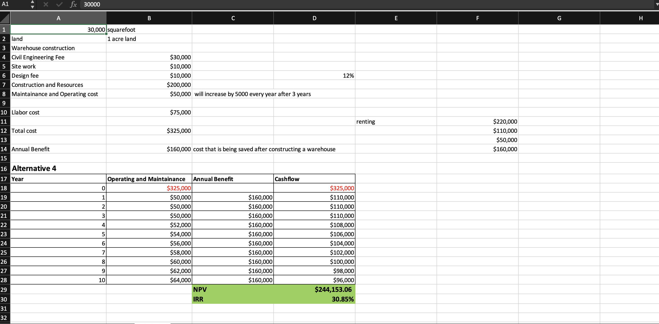
Alternative 4

Slide 10
Results
Alternative 4 will be selected after the economic analysis.
As the NPV is positive, it indicates that the investment is expected to generate more cash than it costs, and therefore may be a profitable opportunity.
The IRR of approximately 31% indicates that the expected rate of return on an investment is 31% per year.

Slide 11
Conclusion
Overall, the economic analysis suggests that the renting half of the warehouse and utilizing the remaining warehouse for transport and storage is a viable investment opportunity with a positive net present value, a favorable internal rate of return.
Thus, it can be concluded that the warehouse construction project is a financially feasible investment opportunity that is likely to provide attractive returns for investors.

